Slide 1
SQL

Slide 2
History of SQL
1970–E. F. Codd develops relational database concept
1974-1979–System R with Sequel (later SQL) created at IBM Research Lab
1979–Oracle markets first relational DB with SQL
1981 – SQL/DS first available RDBMS system on DOS/VSE
Others followed: INGRES (1981), IDM (1982), DG/SGL (1984), Sybase (1986)
1986–ANSI SQL standard released
1989, 1992, 1999, 2003, 2006, 2008–Major ANSI standard updates
Current–SQL is supported by most major database vendors

Slide 3
Purpose of SQL Standard
Specify syntax/semantics for data definition and manipulation
Define data structures and basic operations
Enable portability of database definition and application modules
Allow for later growth/enhancement to standard (referential integrity, transaction management, extended join operations)

Slide 4
Benefits of a Standard
Reduced training costs
Productivity
Application portability
Application longevity
Reduced dependence on a single vendor
Cross-system communication

Slide 5
SQL Environment
Catalog
A set of schemas that constitute the description of a database
Schema
The structure that contains descriptions of objects created by a user (base tables, views, constraints)
Data Definition Language (DDL)
Commands that define a database, including creating, altering, and dropping tables and establishing constraints
Data Manipulation Language (DML)
Commands that maintain and query a database
Data Control Language (DCL)
Commands that control a database, including administering privileges and committing data

Slide 6
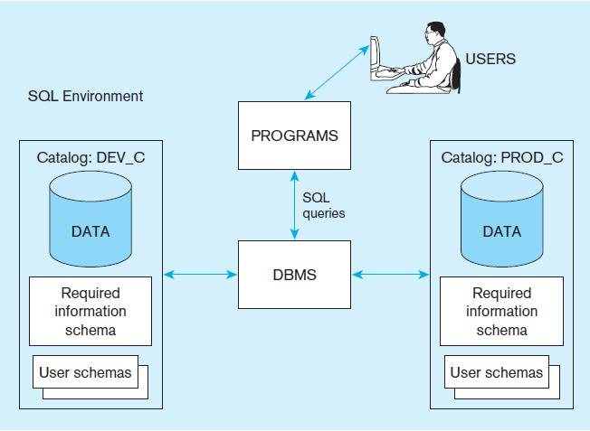
Figure 6-1
A simplified schematic of a typical SQL environment, as described by the SQL: 2008 standard
Chapter 6
Copyright © 2014 Pearson Education, Inc.

Slide 7
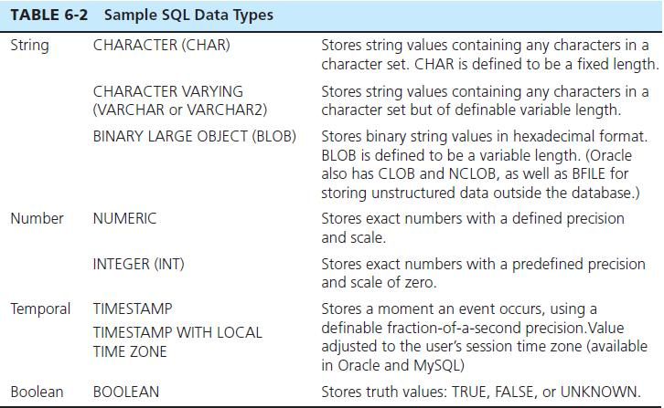
SQL Data Types

Slide 8
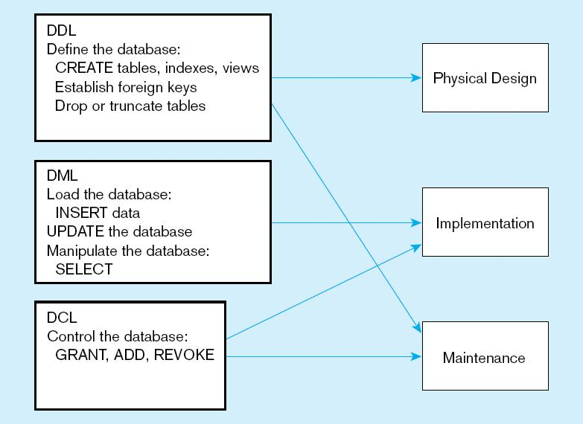
Figure 6-4
DDL, DML, DCL, and the database development process
Chapter 6
Copyright © 2014 Pearson Education, Inc.

Slide 9
Starting MySQL
On the course server enter the command
mysql
You should then see the MySQL prompt
mysql>
To end your MySQL session use the quit command
mysql> quit;

Slide 10
Creating the database
CREATE DATABASE <database name>;
CREATE DATABASE username;

Slide 11
Using a database
USE <database name>;
USE username;
DROP <database name>;
DROP username;

Slide 12
Create Table Example
CREATE TABLE BATCH
(
PartID INT NOT NULL,
PartName VARCHAR(40) NOT NULL,
CatID INT NOT NULL,
PRIMARY KEY (PartID)
);

Slide 13
TABLE BATCH
PartID | PartName | CatiID

Slide 14
Inserting elements
INSERT INTO BATCH
(PartID, PartName, CatID)
VALUES
(1001,'Guy wire assembly',503),
(1002,'Magnet',504);
INSERT INTO BATCH
VALUES
(1003,'Regulator',505);

Slide 15
TABLE Parts
PartID | PartName | CatiID
1001 | Guy wire assembly | 503
1002 | Magnet | 504
1003 | Regulator | 505
1004 | Brushes | 504
1006 | Generator | 506
1006 | Dump load system | 506
1007 | Power assembly | 501

Slide 16
Create Example Tables
Books
Authors
AuthorBook

Slide 17
Create Books Table
CREATE TABLE Books
(
BookID SMALLINT NOT NULL PRIMARY KEY,
BookTitle VARCHAR(60) NOT NULL,
Copyright YEAR NOT NULL
);

Slide 18
Insert data into Books
INSERT INTO Books
VALUES (12786, 'Letters to a Young Poet', 1934),
(13331, 'Winesburg, Ohio', 1919),
(14356, 'Hell\'s Angels', 1966),
(15729, 'Black Elk Speaks', 1932),
(16284, 'Noncomformity', 1996),
(17695, 'A Confederacy of Dunces', 1980),
(19264, 'Postcards', 1992),
(19354, 'The Shipping News', 1993);

Slide 19
Create Authors Table
CREATE TABLE Authors
(
AuthID SMALLINT NOT NULL PRIMARY KEY,
AuthFN VARCHAR(20),
AuthMN VARCHAR(20),
AuthLN VARCHAR(20)
);

Slide 20
Insert data into Books
INSERT INTO Authors
VALUES (1006, 'Hunter', 'S.', 'Thompson'),
(1007, 'Joyce', 'Carol', 'Oates'),
(1008, 'Black', NULL, 'Elk'),
(1009, 'Rainer', 'Maria', 'Rilke'),
(1010, 'John', 'Kennedy', 'Toole'),
(1011, 'John', 'G.', 'Neihardt'),
(1012, 'Annie', NULL, 'Proulx'),
(1013, 'Alan', NULL, 'Watts'),
(1014, 'Nelson', NULL, 'Algren');

Slide 21
Create AuthorBook Table
CREATE TABLE AuthorBook
(
AuthID SMALLINT NOT NULL,
BookID SMALLINT NOT NULL,
PRIMARY KEY (AuthID, BookID),
FOREIGN KEY (AuthID) REFERENCES Authors (AuthID),
FOREIGN KEY (BookID) REFERENCES Books (BookID)
);

Slide 22
Insert Data into AuthorBook
INSERT INTO AuthorBook
VALUES (1006, 14356), (1008, 15729),
(1009, 12786), (1010, 17695),
(1011, 15729), (1012, 19264),
(1012, 19354), (1014, 16284);

Slide 23
SELECT Examples
SELECT * FROM Parts;
SELECT PartID, PartName FROM Parts;
SELECT PartID, PartName FROM Parts
WHERE
CatiID = 504;

Slide 24
Basic Join
SELECT BookTitle, Copyright, Authors.AuthID
FROM Books, AuthorBook, Authors
WHERE
Books.BookID=AuthorBook.BookID
AND
AuthorBook.AuthID=Authors.AuthID
ORDER BY Books.BookTitle;

Slide 26
Basic Join
SELECT BookTitle, Copyright, AuthID
FROM Books AS b, AuthorBook AS ab
WHERE b.BookID=ab.BookID
ORDER BY BookTitle;

Slide 27
Create database
CREATE DATABASE DATABASE_NAME;
Use database
USE DATABASE_NAME;
Create your table of interest
CREATE TABLE TABLE_NAME
(
ATTRIBUTE1 DATA_TYPE(SIZE),
ATTRIBUTE1 DATA_TYPE(SIZE),
ATTRIBUTE1 DATA_TYPE(SIZE),
…....
);

Slide 28
Add primary key
ALTER TABLE TABLE_NAME ADD PRIMARY KEY (ATTRIBUTE_NAME);
Add constraints not null, unique, auto increment
ALTER TABLE TABLE_NAME MODIFY ATTRIBUTE_NAME DATA-TYPE NEW_CONSTRAINS;

Slide 29
Change primary key
ALTER TABLE TABLE_NAME DROP PRIMARY KEY ;
ALTER TABLE TABLE_NAME ADD PRIMARY KEY (ATTRIBUTE_NAME);
(But before dropping the primary key the constraints of attribute must be removed.)
Add column to the required position
ALTER TABLE TABLE_NAME ADD COLUMN_NAME INT AFTER COLUMN_NAME;
Change the name of the column
ALTER TABLE TABLE_NAME CHANGE OLD_COLUMN NEW_COLUMN CONSTRAINS;

Slide 30
Modify column data type and constraint
ALTER TABLE TABLE_NAME MODIFY COLUMN_NAME OLD_CONSTRAINS NEW_CONSTRAINS
Rename column
ALTER TABLE TABLE_NAME CHANGE OLD_COLUMN NEW_COLUMN CONSTRAINS;
Rename table
ALTER TABLE TABLE_NAME RENAME TO NEW_TABLE_NAME;

Slide 31
1.1 List all the databases in mysql.
SHOW DATABASES;
1.2 List all the tables in mysql database
SHOW TABLES;
1.3 Create a table ‘students’ with RollNo, Name, Address, Sex, DoB, Phone, Level as attributes, choose appropriate datatypes, RollNo attribute is a primary key.
CREATE TABLE student (RollNo int primary key, Name varchar(20), Address varchar (50), sex enum(“M”,”F”), DoB date, phone int, Level varchar());

Slide 32
1.4 Insert any Five tuples (Records) in the student tables .
insert into students value(101,’Hari Karki’, ‘Janakpur’, ‘M’, ‘1986-10-12’, 4365456, ‘Bachelor’);
insert into students value(102,’Rajan Shrestha’,’chabahil’,’M’,’1990-01-05’,4253658’,’Master’);
insert into students value(103,’Prakriti Shakya’,’Kathdmandu’,’f’,’1990-01-05’,4325456,’Intermediate’);
insert into students value(104,’Animesh Shrestha’,’kavre’,’M’,’1985-04-02’,01162458,’Master’);
insert into students value(105,’Anisha Pradhan’,’Bkt’,’F’,’1995-08-02’,011662588,’Plus 2’);

Slide 33
1.5 Retrieve all the records of student relation.
select *from student;
1.6 Modify the table student table by removing the attribute Level.
alter table students drop Level;
1.7 Modify (update) date of birth to 16/10/1988 of student with RollNo 101.
update student set DoB = ‘16/10/1988‘ where RollNo = 101;

Slide 34
1.8 Delete the record of student whose address is Janakpur.
delete from student where Address = ‘Janakpur’;
1.9 Delete all the records (data) from the student table.
truncate students;
1.10 Remove the table student from the database.
drop table students;

Slide 35
1.1 Create a database file named emp in MySQL
1.2 Create tables specifying primary key, foreign key and Not Null, unique key constraints for the following schema diagram in emp database. Underline attribute indicates the primary key attribute. Choose appropriate datatypes considering the following data values (Given). Write and executes the appropriate DDL commands
You may use alter commands to add/remove constraints whenever necessary. The arrow indicates the indicated attribute is a foreign key.

Slide 36
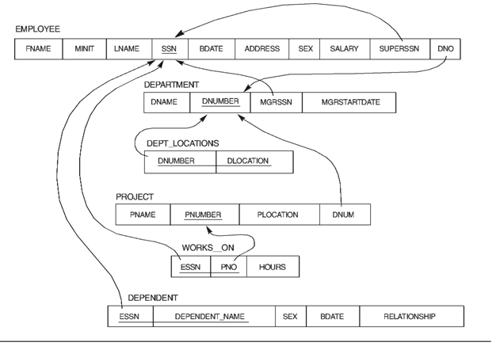

Slide 37
1.1 Create a database file named emp in MySQL
Mysql> Create database emp;

Slide 38
1.2 Create tables specifying primary key, foreign key and Not Null, unique key constraints.
Create table employee.
Mysql > create table Employee(
-> Fname varchar(50) not null,
-> Minit char ,
-> Lname varchar(50) not null,
-> SSN int not null unique,
-> Bdate date not null,
-> Address varchar(50),
-> Sex enum('M','F'),
-> Salary int not null,
-> SuperSSN int not null,
-> DNO int not null,
-> primary key(SSN)
-> );
Query OK, 0 rows affected (0.19 sec)

Slide 39
Create table department.
Mysql > create table department(
-> Dname varchar(40) not null,
-> Dnumber int not null unique,
-> MgrSSN int not null,
-> Mgrstartdate date not null,
-> primary key (Dnumber)
-> );
Query OK, 0 rows affected (0.19 sec)

Slide 40
Create table dept_location
Mysql > create table dept_locations(
-> Dnumber int not null unique,
-> Dlocation varchar(30) not null,
-> primary key (Dnumber, Dlocation)
-> );
Query OK, 0 rows affected (0.16 sec)

Slide 41
Create table project
Mysql > create table project(
-> Pname varchar(30) not null,
-> Pnumber int not null,
-> Plocation varchar(30) not null,
-> DNUM int not null,
-> primary key (Pnumber)
-> );
Query OK, 0 rows affected (0.12 sec)

Slide 42
Create table works_on
Mysql > create table works_on(
-> ESSN int not null,
-> Pno int not null,
-> Hours decimal,
-> primary key (ESSN, Pno)
-> );

Slide 43
Create table dependent
Mysql > create table dependent(
-> ESSN int not null,
-> Dependent_Name varchar(30),
-> Sex enum('M','F'),
-> BDate date,
-> Relationship varchar(30),
-> primary key(ESSN, Dependent_Name)
-> );
Query OK, 0 rows affected (0.18 sec)

Slide 44
Adding Foreign key to the table
Alter table employee add foreign key (SUPERSSN) references employee (SSN);
Alter table employee add foreign key (DNO) references department (DNUMBER);
Alter table department add foreign key (MGRSSN) references employee (SSN);
Alter table dept_locations add foreign key (DNUMBER) references department (DNUMBER);

Slide 45
Alter table project add foreign key (DNUM) references department (DNUMBER);
Alter table works_on add foreign key (ESSN) references employee (SSN);
Alter table works_on add foreign key (PNO) references project (PNUMBER);
Alter table dependent add foreign key (ESSN) references employee (SSN);

Slide 46
Inserting into table Employee
Insert into employee values (‘Doug’, ’E’, ’Gilbert’, 554433221, ’09-JUN-60’, ’11 S 59 E, Salt Lake City, UT’, ‘M’, 80000, NULL, NULL);
Insert into employee values (‘Joyce, NULL, ‘Pan’, 543216789, ’07-FEB-78’, ’35 S 18, Salt Lake City, UT’, ‘F’, 70000, NULL, NULL);
Insert into employee values (‘Frankin’, ’T’, ’Wong’, 333445555, ’08-DEC-45’, ’638 Voss, Houston, TX’, ‘M’, 40000,554433221 , NULL);
Insert into employee values (‘Jennifer’, ’S’, ’Wallace’, 987654321, ’20-JUN-31’, ’291 Berry, Bellaire, TX’, ‘F’, 43000,554433221, NULL);
Insert into employee values (‘John’,, ‘B’, ‘Smith’, 123456789, ’09-JAN-55’,’731 Fondren, Houston,TX’,’M’,30000,333445555, NULL);
Insert into employee values (‘Ramesh’, ‘K’, ‘Narayan’, 666884444, ’15-SEP-62’, ‘975 Fire Oak, Humble, TX’, ‘M’, 38000, 333445555, NULL);
Insert into employee values (‘Joyce’, ‘A’, ‘English’, 453453453, ’31-JUL-62’, ‘5631 Rice, Houston, TX’, ‘F’,25000,333445555,NULL);

Slide 47
Inserting into table Department
Insert into department (‘Manufacture ‘, 1 , 888665555, ’19-JUN-71‘);
Insert into department (‘ Administration‘, 2 ,543216789, ’04-JAN-99‘);
Insert into department (‘Headquater‘,3, ‘554433221, ’22-SEP-55’);
Insert into department (‘Finance‘,4 , ‘987654321, ’01-JAN-85’);
Insert into department (‘ Research‘,5,333445555 , ’22-MAY-78 ‘);

Slide 48
Inserting into Dept_Location
insert into dept_location values(2,'San Francisco');
insert into dept_location values(4,'Stafford');
insert into dept_location values(4,'Bellaire');
insert into dept_location values(5,'Sugarland');
insert into dept_location values(5,'Houstan');

Slide 49
1 List the names of all employees who work in department 5.
select *from Employee where DNO = 5;
2 List names and salaries of all employee and ordered by salary.
Select Fname, Lname, Salary from Employee order by Salary;
3 Find the name (s) of employees whose salary is between 30000 and 50000.
select Fname, LName, Salary from Employee where Salary > 30000 AND Salary < 50000;

Slide 50
4 Find the name and address of employees who lives in Houston.
Select FName, LName, Address from Employee where Address like "%Houston%";
5 Find the name of all female employees.
Select FName, Lname, Sex from Employee where Sex = 'F';
6 List Project name(s) located at Salt Lake City
select PName, PLocation from Project Where PLocation = "Salt Lake City";

Slide 51
7 Find the name(s) of the dependent with relationship son.
select Dependent_Name, Relationship from Dependent where Relationship = "Son";
8 Find the maximum , minimum, total and average salary of
employee.
Select max(Salary), min(Salary), sum(Salary), avg(salary) from Employee;
9 Find the full name of the employee who has maximum salary.
select FName, LName, max(Salary) from Employee;

Slide 52
10 Find the full name of the employee who has
minimum salary
select FName, LName, min(Salary) from Employee;
11 List full names and salaries of all the employee
who have the salary Greater than the
average salary
Select Fname, Minit, Lname, Salary from Employee where Salary = (select avg(Salary) from Employee);

Slide 53
12 Count the number employee who have salary greater than 30000.
select count(Salary) from Employee where Salary>30000;
13 Retrieve the birthdate and address of the employee
whose name is 'John B. Smith'.
select BDate, Address, FName from Employee where FName = 'John' AND Minit = 'B' AND LName = 'Smith'

Slide 54
14 Retrieve the name and address of all employees who work for the 'Research‘ department.
Select Fname, Lname, Address from Employee join Department where DNO = Dnumber AND Dname = 'Research';
15 Retrieve the social security numbers of all employees who work on project number 1, 2, or 3.(Use IN connective)
select SSN, Fname, Pname from Employee join Project where DNO = DNumber Pnumber IN (1,2,3);

